Slide 1
Week 2
BEFORE THE Relational moDEL– Some History

Slide 2
Student Objectives
Upon completion of this video, you should be able to:
List 2 of the models that were used before the relational model to build databases

Slide 3
The Problem:
Now that we have figured out how to represent our data as a simple paper MODEL (the ER Diagram)….. How do we translate that ER model to a REAL working database on a computer?

Slide 4
A little history…
The Hierarchical Model
The Network Model

Slide 5
Hierarchical Data Model
Most popular DBMS using this model is IBM's IMS (STILL BEING USED!)
Based on 2 main concepts: records and parent-child relationships. Records are grouped into record types
A parent-child relationship type is a 1:M relationship between 2 record types
An occurrence (instance) of a PCR is 1 parent record type and a number of records from the child type

Slide 6
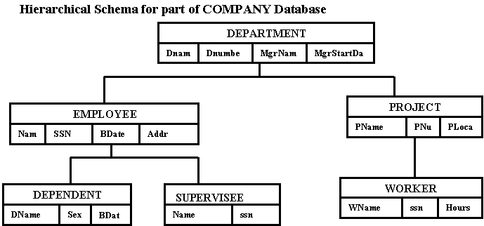
Example:
Question: Can you see where there will be data redundancy (a problem)?

Slide 7
What is the problem…
with the Hierarchical Model?

Slide 8
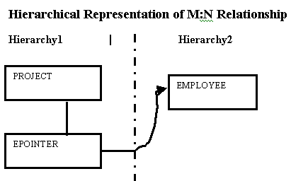
Rules for Mapping ER Diagram to Hierarchical Model:
In Hierarchical Models only 1:N representations can be modeled so for M:N relationships represent them as if they were 1:N relationships, and use pointers to save on duplication of data
Has problems modeling the following situations:
M:N relationships
The case where a record type participates as child in more than 1 PCR type
N-ary relationships with more than 2 participating types

Slide 9
Network Data Model
Designed and created by the CODASYL (Conference on Data System Languages) committee in 1971
Often called the CODASYL Model (popular DBMS using this model is IDMS)
Two basic data structures: Records and Sets
Data stored as Records, Records as classified into Record Types (Record Types have a name and format for each data item)

Slide 10
Set type is a 1:N relationship between 2 record types. Each set type consists of 3 elements
A name for the set
An owner record type
A member record type
A record type can participate as an owner or member in any number of set types
Uses circular linked lists

Slide 11
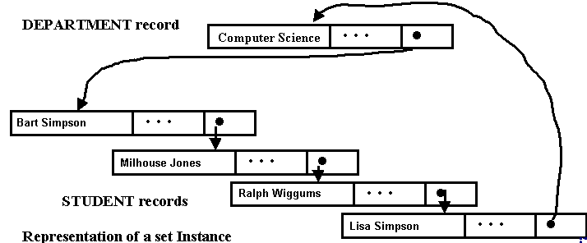
Example:
This model allows us to do things such as:
Given an owner record, find all member records of the set occurrence
Given an owner record, find the first or nth, or last record of that set occurrence
Given a member record, find the next or previous member record
Given a member record, find the owner record

Slide 12
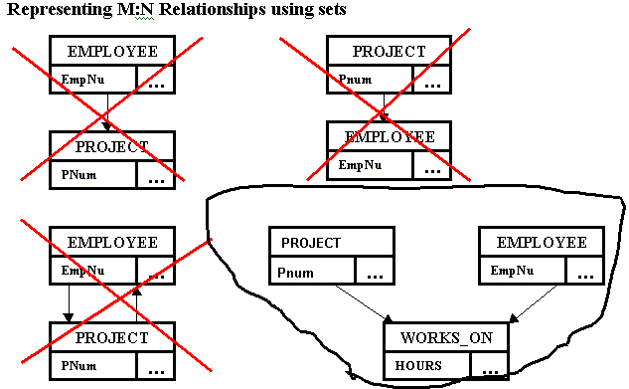

Slide 13
Rules for Mapping an ER diagram to Network Model
Step 1: Regular Entities --> Create a record type
Step 2: Weak Entities --> Create a record type
Step 3: One to One and One to Many --> Create a set type relating record type S1 to S2. For one-to-one arbitrarily choose one of S1 or S2 as owner, for one-to-many choose make the owner be the One side of the One-to-Many relationship
Step 4: Many to Many --> Create a linking type X and make it the member record type in the 2 set types.

Slide 14
Relational Data Model
Introduced by Codd in 1970
Most DBMS are based on this model
Represents the database as a collection of relations.
Each relation is a table: a table is a set of rows, where each row in the table represents a collection of related data values

